Slide 1

Customer Shopping Behavior Analysis
Uncovering insights from transactional data to drive strategic business decisions.

Slide 2
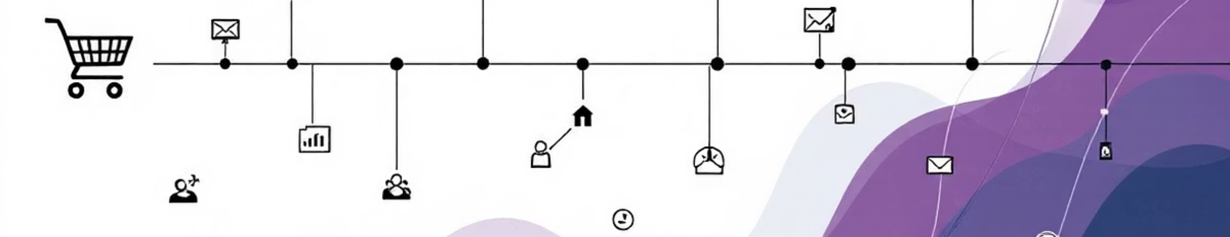
Project Overview
Goal
Purpose
Analyze 3,900 purchases to understand spending patterns, segments, and preferences.
Guide strategic business decisions through data-driven insights.

Slide 3
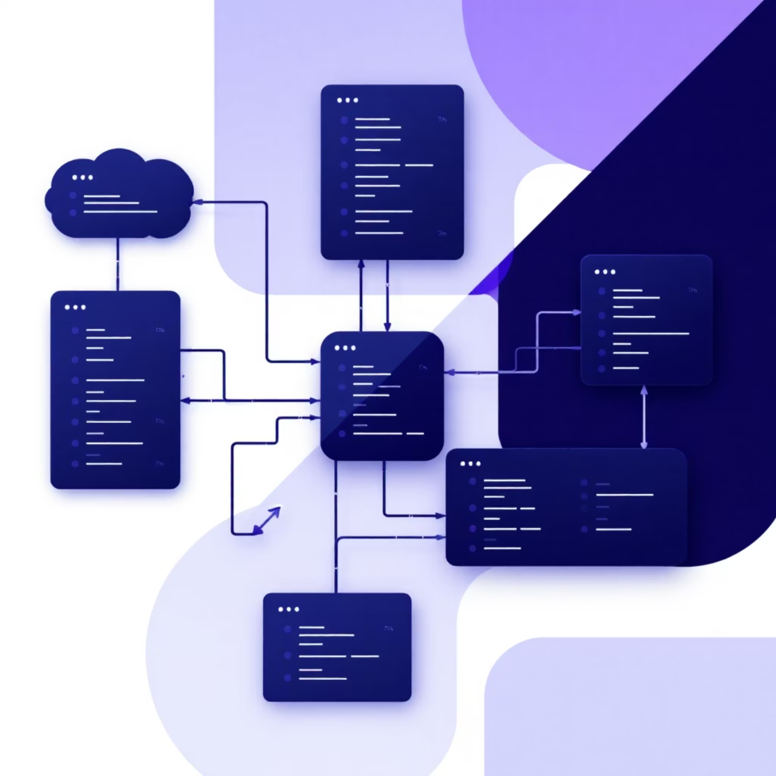
Dataset Summary
Rows
3,900
Columns
18
Key features include demographics, purchase details, and shopping behavior.

Slide 4
Exploratory Data Analysis (Python)
01
02
03
Data Preparation
Column Standardization
Feature Engineering
Loading, initial exploration, and handling missing values in 'Review Rating'.
Renamed columns to snake case for readability.
Created 'age_group' and 'purchase_frequency_days'.
04
05
Data Consistency
Database Integration
Verified and dropped redundant 'promo_code_used'.
Loaded cleaned data into PostgreSQL for SQL analysis.

Slide 5
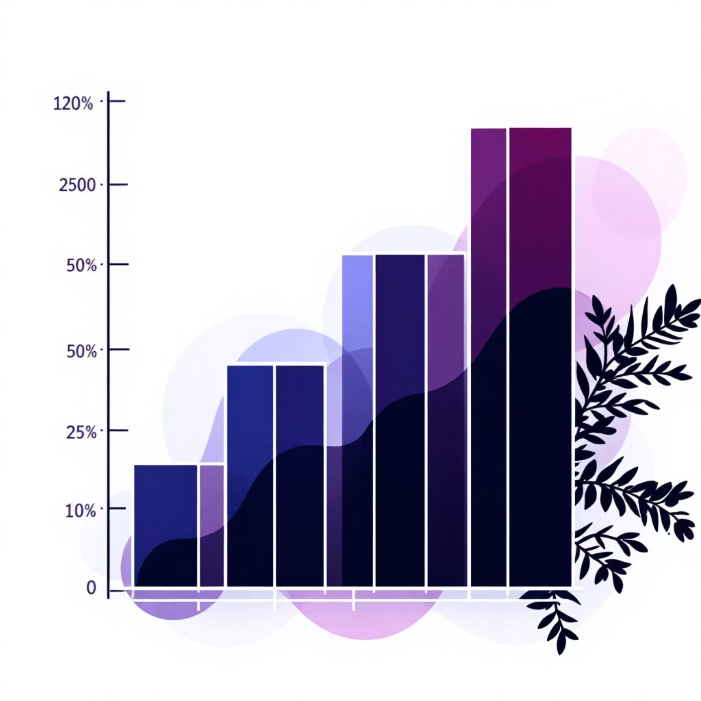
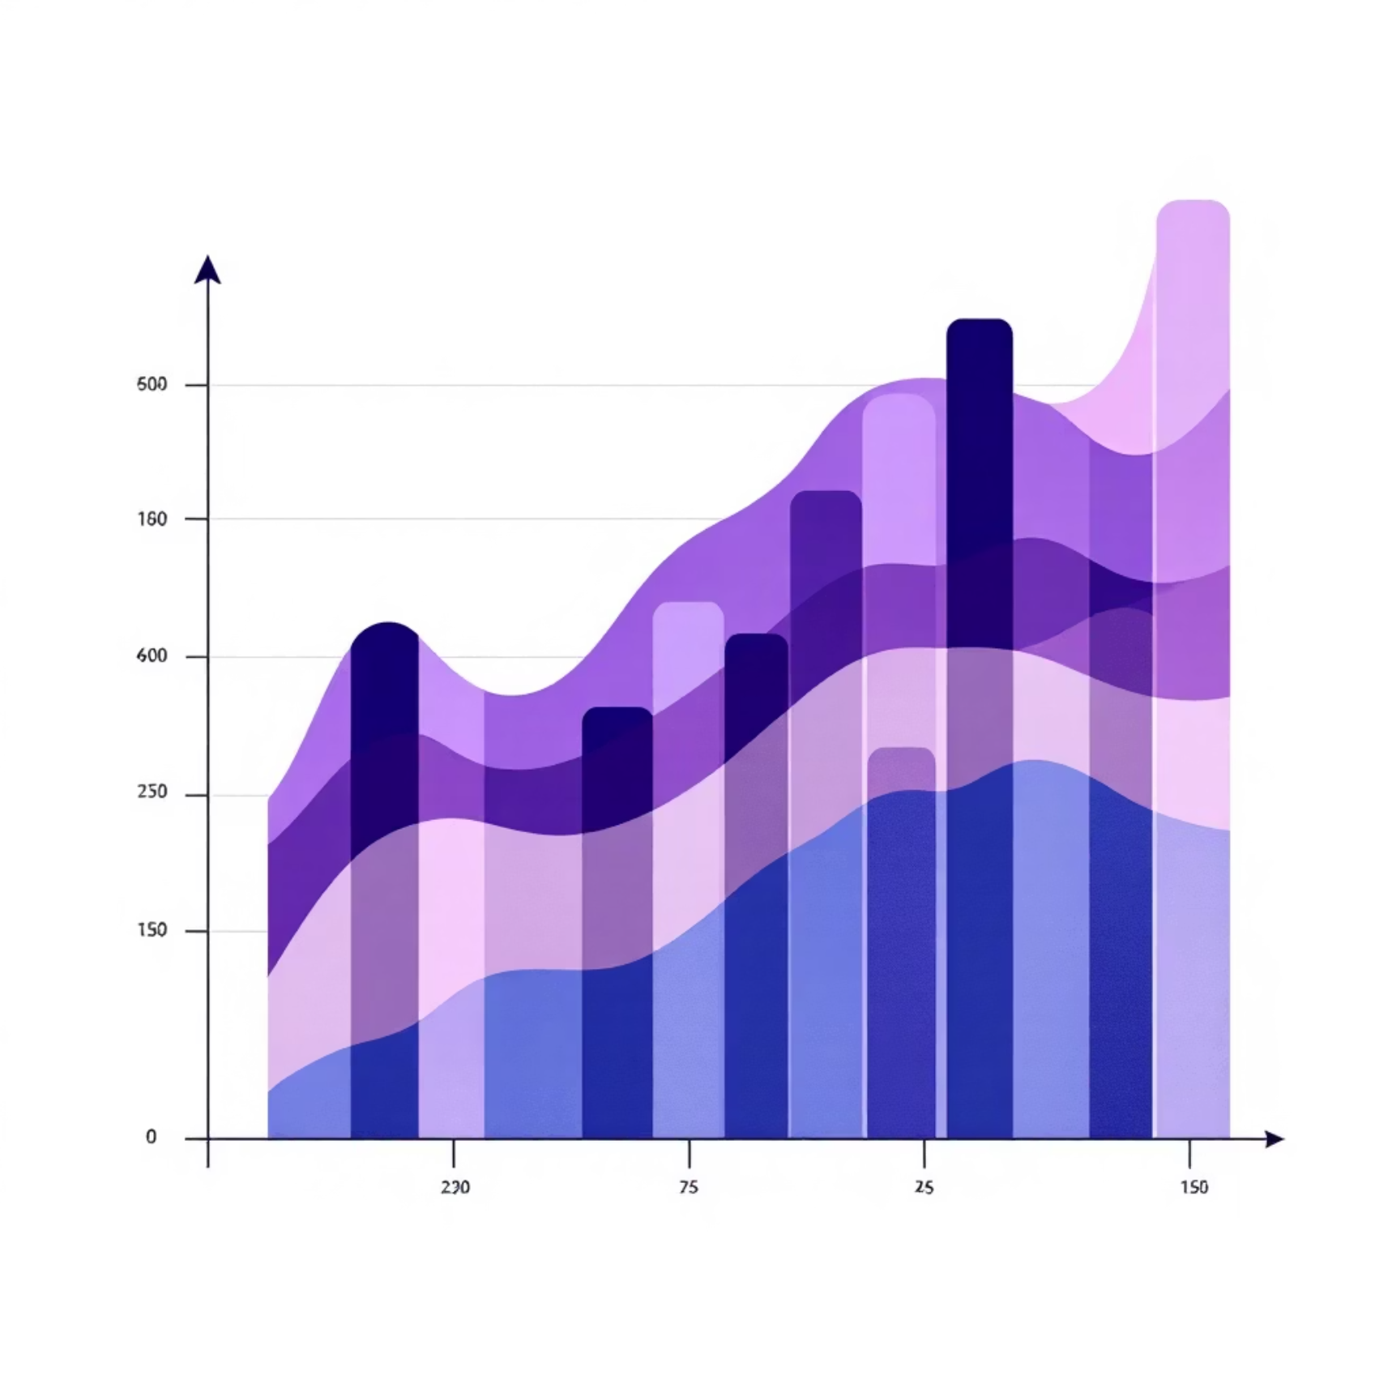
Data Analysis (SQL) - Revenue Insights
Revenue by Gender
Revenue by Age Group
Compared total revenue generated by male vs. female customers.
Calculated total revenue contribution of each age group.

Slide 6

Data Analysis (SQL) - Customer Behavior
1
2
3
High-Spending Discount Users
Subscribers vs. Non-Subscribers
Repeat Buyers & Subscriptions
Identified customers who used discounts but spent above average.
Compared average spend and total revenue across subscription statuses.
Checked if customers with >5 purchases are more likely to subscribe.

Slide 7


Data Analysis (SQL) - Product & Shipping
Top 5 Products by Rating
Shipping Type Comparison
Found products with the highest average review ratings.
Compared average purchase amounts between Standard and Express shipping.

Slide 8
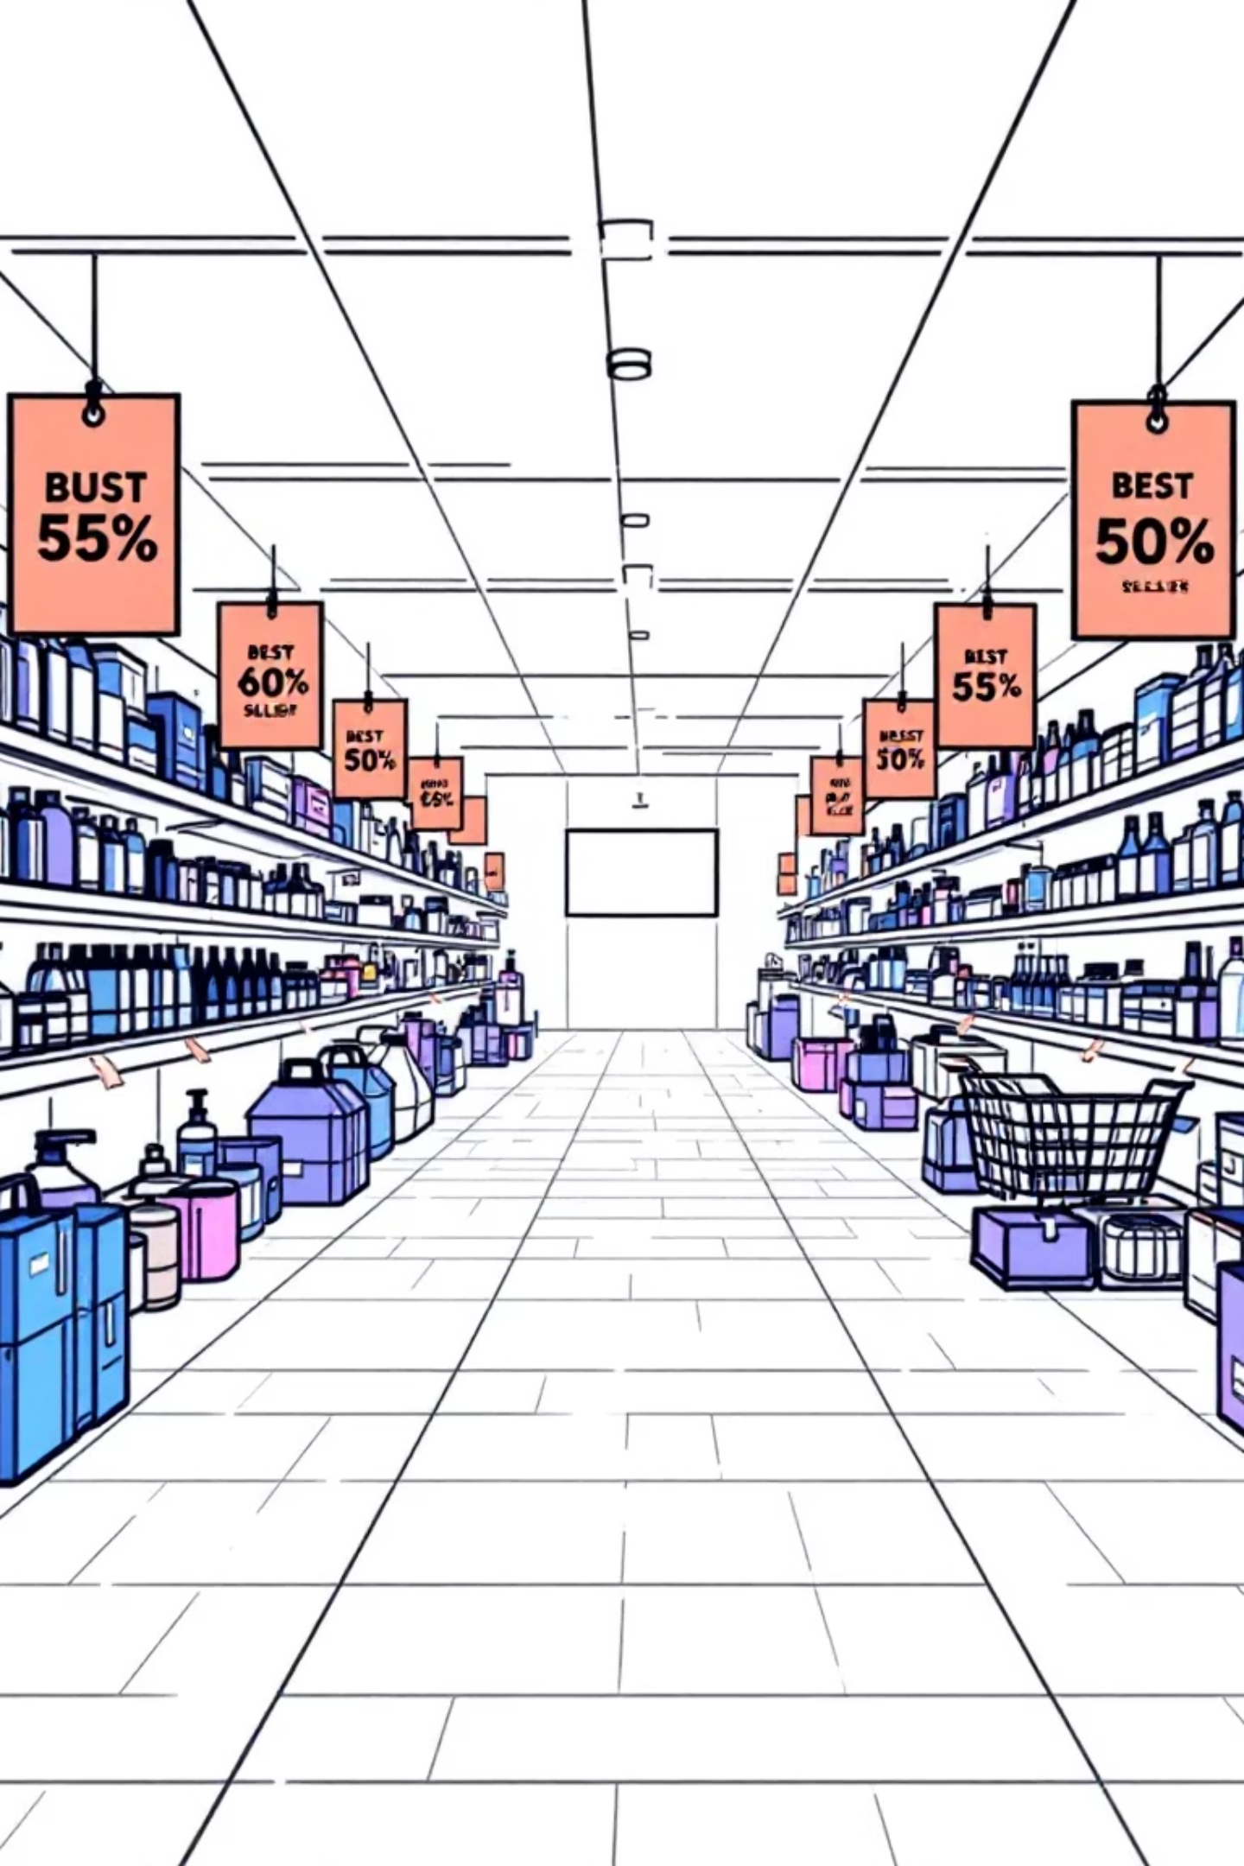
Data Analysis (SQL) - Discount & Product Focus
Discount-Dependent Products
Identified 5 products with the highest percentage of discounted purchases.
Top 3 Products per Category
Listed the most purchased products within each category.

Slide 9
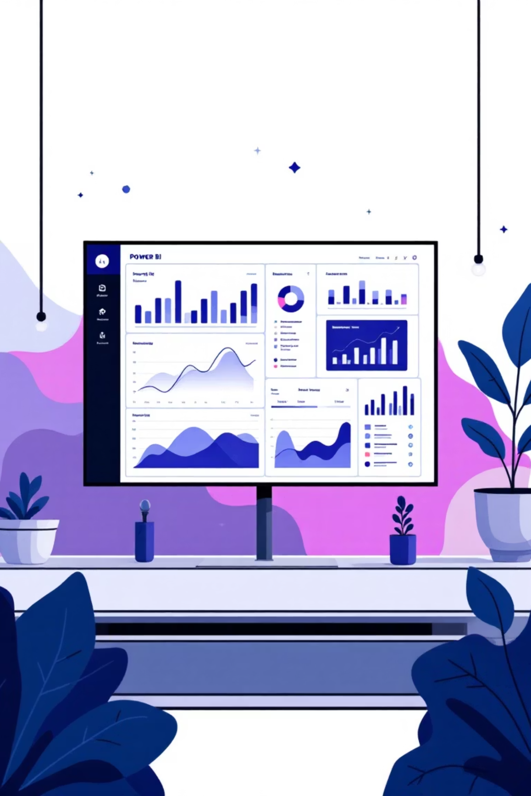
Dashboard in Power BI
An interactive dashboard was built to present all insights visually.

Slide 10
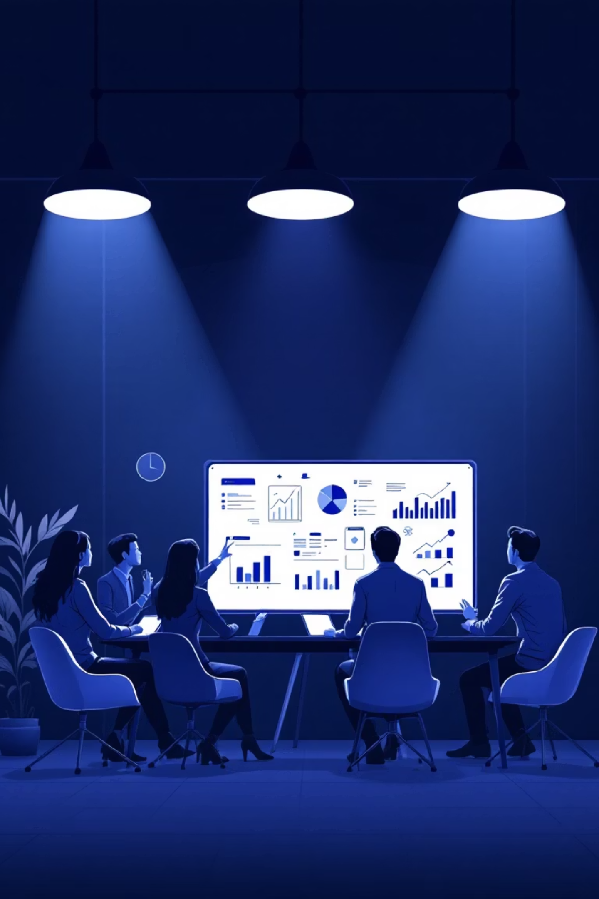

Business Recommendations
Boost Subscriptions
Promote exclusive benefits for subscribers.
Customer Loyalty Programs
Reward repeat buyers to foster loyalty.
Review Discount Policy
Balance sales boosts with margin control.
Targeted Marketing
Focus efforts on high-revenue age groups and express-shipping users.

